Slide 1
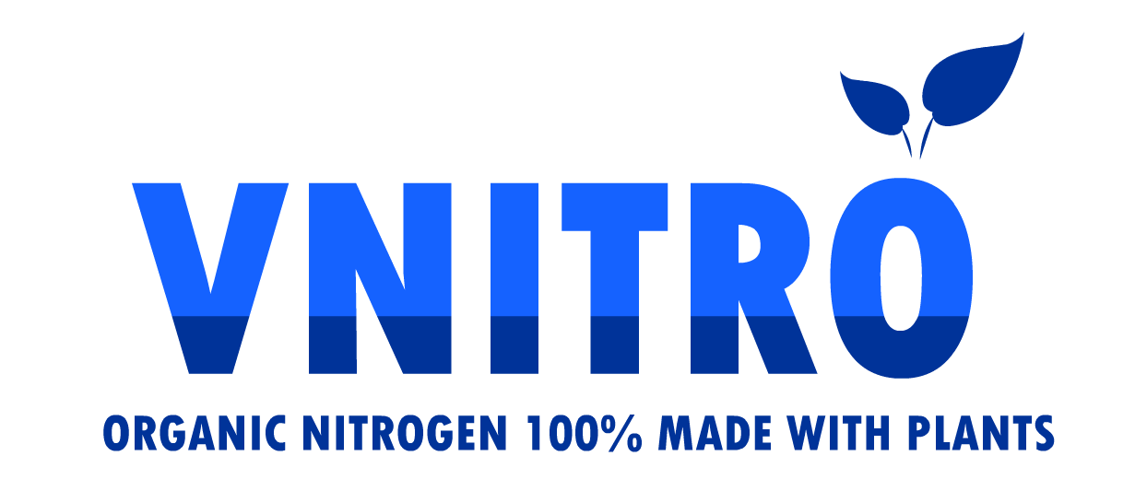
INTRODUCTION TO VNITRO THE GREEN NITROGEN

Slide 2
VNITRO, THE GREEN NITROGEN
VNITRO is a CE LIQUID ORGANIC FERTILIZAR that complies with the Regulation (EU) 2019/1009, which establishes the provisions relating to the placing on the market of CE fertilizer products.
VNITRO is the acronym for VEGETABLE NITROGEN and is found within the range of new and innovative products, which under the CHAMAE brand, they are produced and marketed from the second half of 2022.
Designed and manufactured by KERVRAN LABS and marketed by AGROZERO, owners of the CHAMAE brand, it is produced in Malaga, Andalusia, SPAIN.
It is marketed exclusively by CHAMAE distributors.

Slide 3
VNITRO, HOW ITS MADE (I)
The production and extraction of nutrients is carried out from plant resources and tissues, that is, pruning remains and other free plant resources or crop residues.
It is in the organic matrix of these raw materials that the nutrient to be obtained is found: NITROGEN (N) associated with CALCIUM (Ca), MAGNESIUM (Mg), MANGANESE (Mn), IRON (Fe) and SILICON (Si) in a complex form. This association is possible thanks to the fact that all these elements are found in an organic matrix that allows their natural compatibility.
In the production of VNITRO, short-chain carboxylic acids of plant and/or food origin are used as modifiers or complements to natural processes.

Slide 4
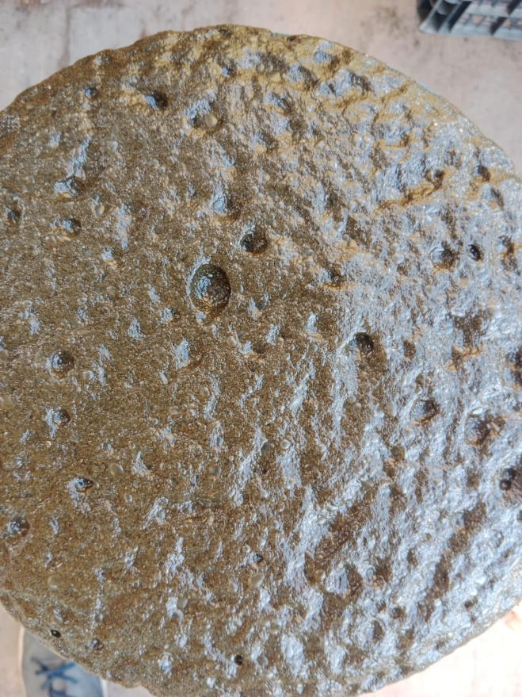
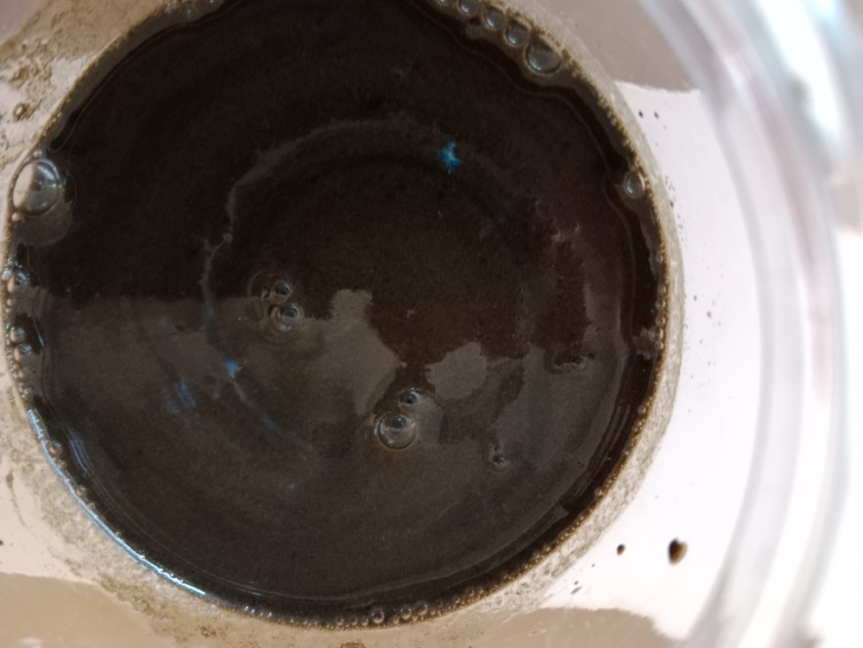
VNITRO, HOW IT MADE (II)
INITIAL PHASE
PLANT TISSUES
STEP 1
MACERATION
CONCENTRATION,
NATURAL EVOLUTION
STEP 2
PURIFICATION AND FILTERING

Slide 5
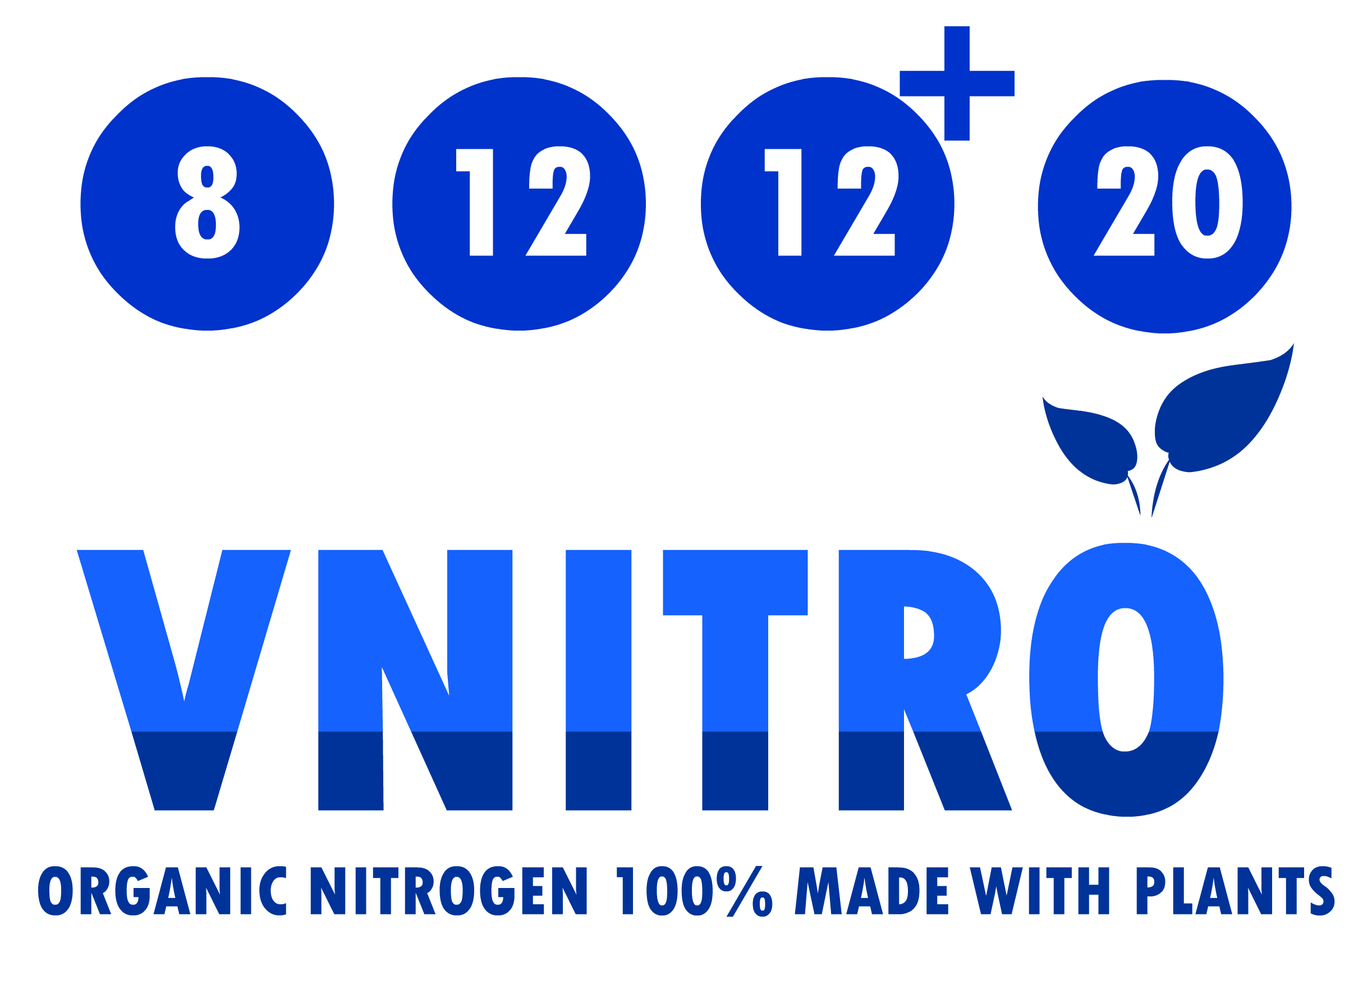

Slide 6
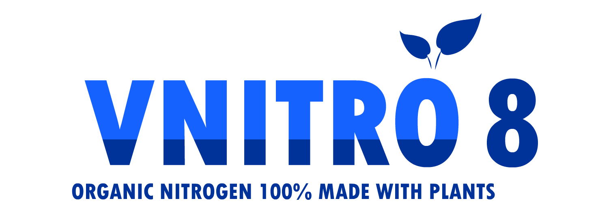
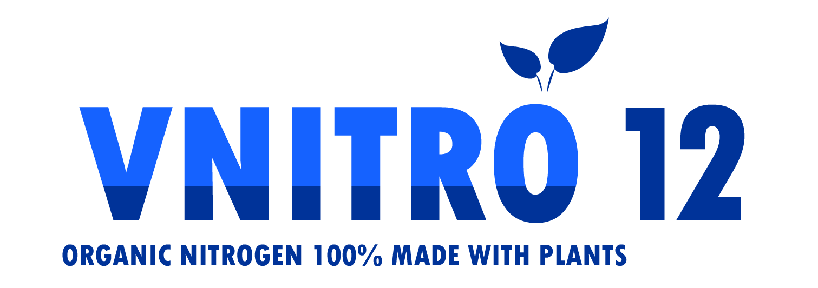
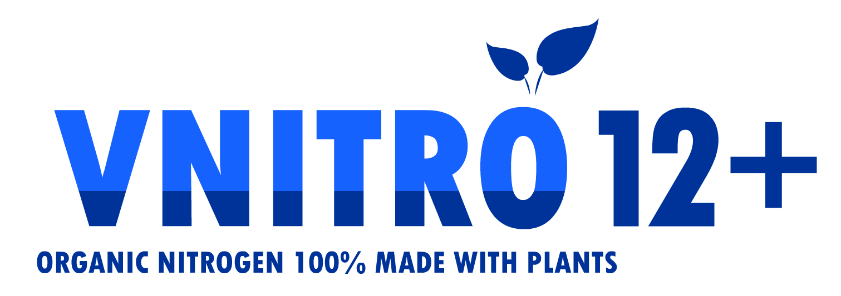
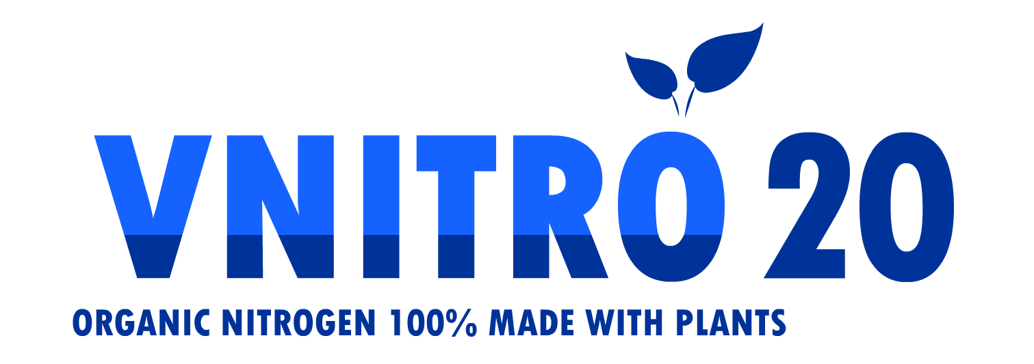
8 UNITS OF ORGANIC NITROGEN For a continuous foliar application. |  | 12 UNITS OF ORGANIC NITROGEN For all types of crops, foliar and irrigation.
12 UNITS ORGANIC NITROGEN + AMINOACIDS For crops with extraordinary needs due to stress |  | UNITS OF ORGANIC NITROGE Perfect Solution for greenhouses or direct sowing
4 DIFFERENT & SPECIALIZED CONCENTRATIONS
ORGANIC MATRIX: NITROGEN + (Potassium, Calcium, Silicon, Iron and Magnesium)...

Slide 7
VNITRO ADVANTAGES
IMPROVING THE EFFICIENCY OF NUTRITIONAL PRODUCTS
It is important to remember that VNITRO contains other cations such as POTASSIUM CALCIUM, MAGNESIUM AND IRON, among others, in its organic matrix, so its application does not lead to deficiencies of these elements caused by antagonism.
Any nutrient of plant origin is MUCH MORE EASILY ASSEMBLE AND METABOLIZED with less energy effort by the plant.
VNITRO ENRICHES THE SOIL, unlike other forms of inorganic or organic nitrogen, which lead to soil contamination due to the accumulation of salts that are not bioavailaible. Its organic nature favors the development of microorganisms in the root environment, also contributing to the better assimilation of other nutrients.
And its low level of salinity due to its 100% organic origin

Slide 8
APPLICATION & DOSAGE
You must use VNITRO in the same way that you would use any other Nitrogenous Liquid Fertilizer, taking into account that its organic nature can multiply its efficiency up to 3 or even more, since it is NATURAL ORGANIC NITROGEN.
VNITRO stands out for the synergistic contribution of its elements and its rapid foliar absorption.
It can be applied by foliar spray or through irrigation systems in any type of crop.
It should be applied at the beginning of the vegetative cycle and during the development stage, in periods of little mineralization and after periods of drought, cold or stress

Slide 9
APPLICATION & DOSAGE. SAMPLES (I)
Dosage VNITRO 20
The number of applications depends on the type of crop and its phenological state.
Foliar Application
Cereals: 5-10 L/ha at the end of tillering-tillering, 5-10 L/ha in flag leaf and 10-15 L/ha after the appearance of the spike.
Rapeseed: 5-10 L/ha at the beginning of stem elongation ("rosette").
Vegetables of the brassica genus, leek, soybean and bean: 5-10 L/ha, with sufficient foliar development.

Slide 10
APPLICATION & DOSAGE. SAMPLES (II)
Dosage VNITRO 20
Sugar beet: 5-10 L/ha, in a state of 4-6 leaves and row closure, do not apply after row closure.
Corn: 10 L/ha and application, from the stage of 6 leaves until the beginning of flowering;
Potato: 10 L/ha and application when the plant reaches 10 cm in height, repeat after 15 days. Apply when the foliage of the crop is dry.
Use the volume in 150-200 L/ha of water, ensuring optimal foliar coverage.

Slide 11
APPLICATION & DOSAGE. SAMPLES (III)
Dosage VNITRO 20
To ensure optimal penetration of the product, apply without rain forecast
for 3-4 hours.
It is not recommended to apply in unfavorable conditions for the crop such as dry winds, diseases, temperatures above 27 ºC. Do not treat in full bloom.
Do not apply foliarly in fruit trees and vines.

Slide 12
VNITRO MANUFACTURED & MARKETED
BY KERVRAN LABS AND AGROZERO:
Email: chamae@chamae.es Whatsapp: +34 654 45 66 01 Telegram: CHAMAE INFO Youtube: Efecto-CHAMAE Facebook: fertilizante.organico

