Slide 1
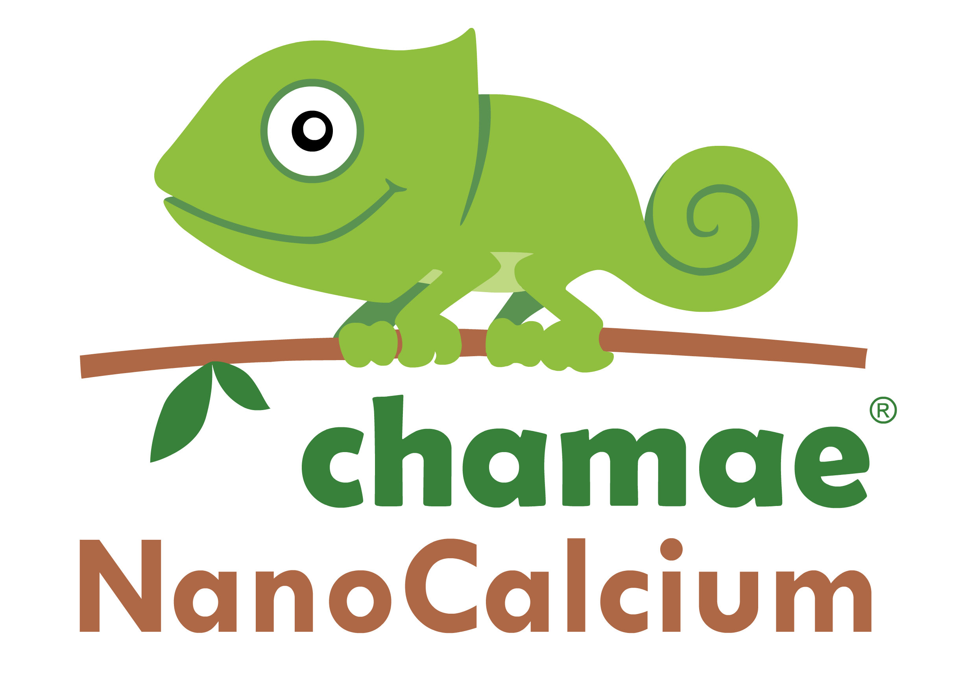
Introduction to NanoCalcium THE EFFICIENT CALCIUM

Slide 2
NanoCalcium, THE EFFICIENT CALCIUM
NanoCalcium and Liquid NanoCalcium are CE organic fertilizers that comply with the provisions of Regulation (EU) 2019/1009, which establishes the provisions relating to the placing on the market of CE fertilizer products.
NanoCalcium CHAMAE are the most effective calcium amendments, as a result, but above all because of costs, because of the non-existent cost of transport and application, and because they improve soils without leaving residues of carbonates or sulfates that block or immobilize nutrients, in addition to contamination. environment they can produce.
NanoCalcium and Liquid NanoCalcium are within the range of innovative products, under the CHAMAE brand.

Slide 3
NanoCalcium, THE EFFICIENT CALCIUM
NanoCalcium and Liquido NanoCalcium propose the use of sustainable nutrients, and that efficiently improve agriculture.
Only sustainable resources are used for its production, inexhaustible sources such as: shells of marine mollusks and carboxylic acids of natural origin not used in food production.
ECOLOGICAL, SUSTAINABLE AND 100% ORGANIC
NanoCalcium and Liquid NanoCalcium, are produced with sustainable sources locally sourced, without pollution or the need for heavy industry
and with 0 CARBON FOOTPRINT.

Slide 4
ORGANIC NATURAL CALCIUM BUT NON-MINERAL SOURCE
Calcium is currently obtained from mineral sources and is marketed
in different formats to be used in agriculture.
The current global economic situation, as well as the urgent need to advance towards a sustainable agricultural model, both economically and environmentally, requires an alternative model.
Within the general model of natural organic production of the CHAMAE model, CALCIUM, sustainable, non-polluting (due to its extraction processes) and of local origin for our farmers, is obtained from mollusk shell remains, the calcium contained in this natural resource does not mineral and inexhaustible is subjected to simple and natural processes.

Slide 5
NanoCalcium, How its made (II)
MOLLUSC SHELL
GRINDING
SEPARATION OF CARBONATE FROM CALCIUM
CALCIUM HYDRATION
SOLUBILIZATION WITH CARBOXYLIC ACIDS OF THE SOLID FRACTION
NanoCalcium: Ca + Mg + Fe + Si
EDTA, EDHA, OR ANY OTHER CHEMICAL/SYNTHETIC CHELATORS ARE USED

Slide 6
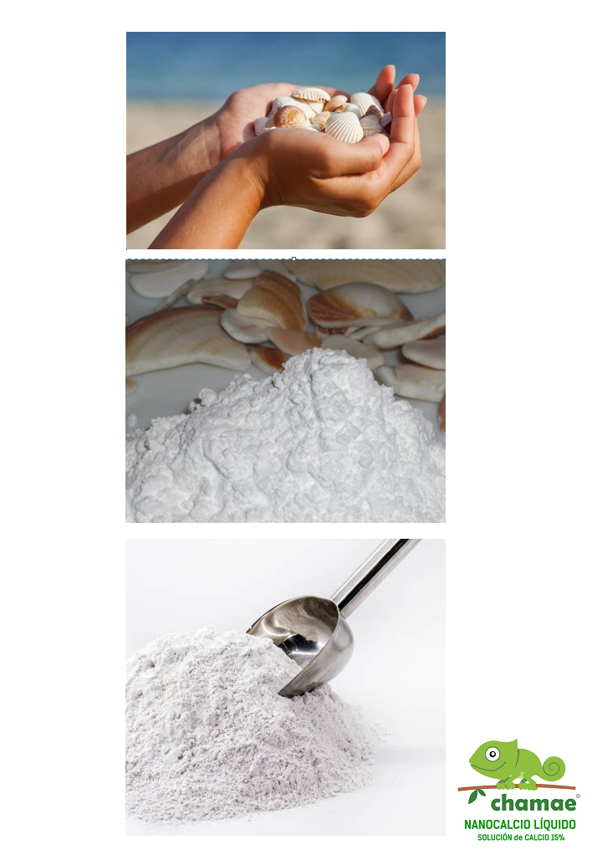
NanoCalcium, How its made(II)
INITIALS TAGE
MOLLUSC SHELLS
STAGE 1
GRINDING OBTAINING CALCIUM CARBONATE
STAGE 2 -3
CARBONATE SEPARATION AND HYDRATION TO
OBTAIN CALCIUM HYDROXIDE

Slide 7
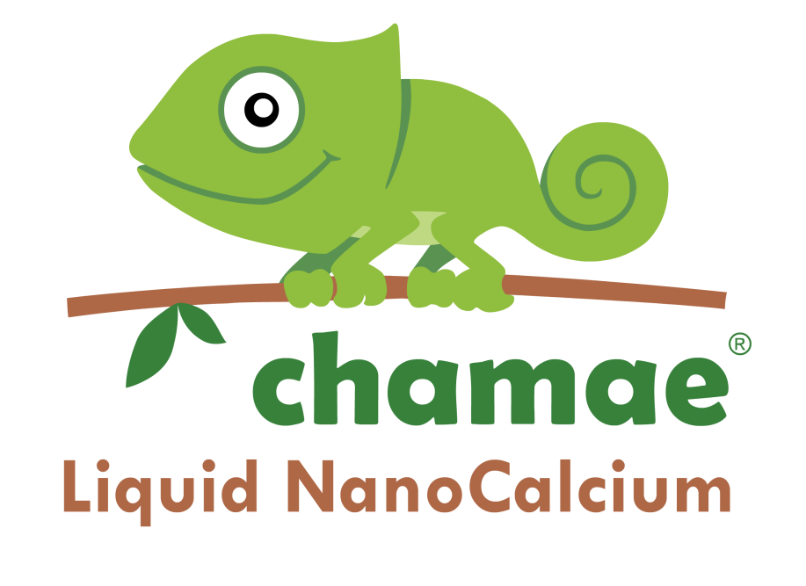
Organic calcium hydroxide 96.5% (% w/w CaOH_{‎2}‎) 70% (% w/w CaO) For all crops, foliar and irrigation uses. 800 grs/hectare according to recommended doses |  | 15% organic calcium solution (% w/w CaO) For all types of crops, foliar use and irrigation in the recommended doses. With the advantages of natural carboxylic acids.
2 DIFFERENT AND SPECIALIZED MODELS
+ Silicon, Magnesium and Iron.

Slide 8
NanoCalcium CHAMAE Advantages
IMPROVING THE EFFICIENCY OF NUTRITIONAL PRODUCTS
It is important to remember that NanoCalcium contains other cations such as magnesium and iron, although at minimal levels.
It enriches the soil, unlike other forms of inorganic calcium that lead to soil contamination due to the accumulation of less bioavailable salts, carbonates, sulphates, etc.
Its organic nature favors the development of microorganisms in the root environment, also contributing to the better assimilation of other nutrients.

Slide 9
NanoCalcium CHAMAE Advantages (II)
ENVIRONMENTAL SUSTAINABILITY
The pollution generated by the activity and mining during its production is reduced.
Subsequent industrial pollution is reduced for the purification or clean extraction of the element.
The pollution produced by the transport of the product is reduced, as it is produced locally or nearby.
RENEWABLE RESOURCES are used.

Slide 10
NanoCalcium EFFICIENCY Sample
Below and just as an example we describe a first application of CHAMAE NanoCalcium in an extreme situation and in soils very damaged by mining activity, which are intended to be recovered. The SUPERIORITY, the great benefits and improvements that CHAMAE NanoCalcium entails compared to any other calcium amendment or corrector is evident in just one first application.
LOCATION: Galicia, Spain
PROBLEM: Soils after mining extraction were left without structure to carry out a crop. Initially, 2,000 kg of magnesian lime were applied for each hectare to correct the pH and calcium of the soil.
APPLICATION TEST WITH NANOCALCIUM: 800 grams of CHAMAE NanoCalcium applied per hectare with a volume of 400 liters of broth gave the following optimal results for correcting soil pH and calcium.

Slide 11
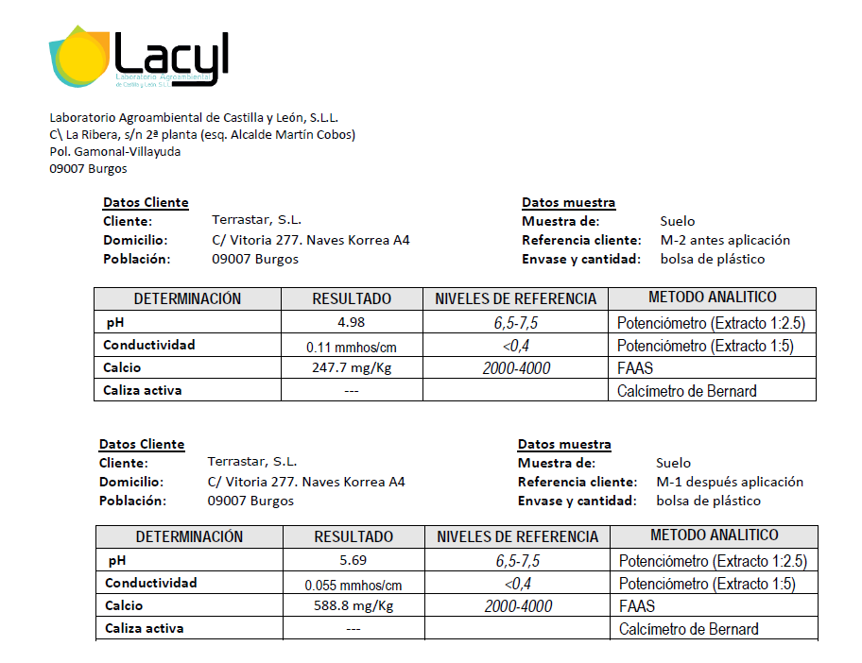
NanoCalcium EFFICIENCY Analitycs (II)

Slide 12
EFFICIENCY of NanoCalcium, CONCLUSIONS (I)
Results with only 1 APPLICATION 800 grams of CHAMAE NanoCalcium in 1 hectare of damaged soil.
Initial soil pH 4.98
Soil pH after one application 5.69
The pH increased 0.72 units with just one application. It is important to take into account the adverse conditions during the test, which was carried out in Galicia in autumn during the rainy season that washed the soil.
Calcium level in soil before application: 247.7 mg/ Kg.
Calcium level in soil after applying CHAMAE NanoCalcium : 588.8 mg/ Kg.
The calcium level after application exceeds twice the initial value. Only with two more applications the reference values for calcium would have been reached since CHAMAE NanoCalcium not only provides calcium but also favors the microbial activity of the soil and therefore the release and availability of calcium as well as other elements necessary for the plant..

Slide 13
EFFICIENCY of NanoCalcium, CONCLUSIONS(II)
Soil conductivity before application 0.11 mΩ/cm
Soil conductivity after applying 0.055 mΩ/cm
More nutrient but less conductivity.
I ts incorporation into the humic clay complex and the activation of the decomposing mechanisms of the microorganisms that improve the quality of the soil are demonstrated.

Slide 14
NanoCalcium: DOSAGE & APPICATION
CROP | DOSAGE PER APPLICATION | APPLICATION
OLIVE TREES | 200 a 500 cc/Hl | FOLIAR: from 200 to 500 ml in 100 liters of water, 3 or 4 repetitions, every 3 weeks, starting the first one after fruit set.
 | 5 liters/Ha-year | IRRIGATION
FRUIT TREES | 5 liters/Ha-year | IRRIGATION
 | 200 a 500 cc/Hl | FOLIAR: From 3 to 5 applications beginning the first with the fall of the petals with intervals of 2 to 3 weeks
CÍTRUS | 5 liters/Ha-año | FERTIRRIEGO
 | 200 a 500 cc/Hl | FOLIAR: from 200 to 500 ml in 100 liters of water, 3 or 4 repetitions, every 3 weeks, starting the first one after fruit set.
VINEYARD | 5 liters/Ha-year | IRRIGATION
 | 200-250 ml/hl Up to 5 applications | FOLIAR: from 200 to 500 ml in 100 liters of water, 3 or 4 repetitions, every 3 weeks, starting the first one after fruit set.
VEGETABLES/GREENHOUSE | De 5 a 15 liters/Ha-year | IRRIGATION
 | 300-500 ml/Hl/application | FOLIAR: with an interval of 12 to 14 days. The first application from the setting or formation of the first leaves.

Slide 15
GREENHOUSE DOSAGE
Greenhouse dose of CHAMAE Liquid NanoCalcium:
Campaign of 6 MONTHS: 2 jars of 5 liters
Campaign of 6 MONTHS: 3 jars of 5 liters
The amounts can vary up to 20% depending on the crop, variety and quality and
type of other inputs used.
It is the alternative to calcium currently applied in bags/bottles of 25 kilos/liters, with an approximate cost of 1,300 euros per Ha and a 9-month campaign.
Advantages: to the lower cost of the product, we must add the advantage that it does not accumulate in the soil forming crusts of salts that must be eliminated to avoid blockages of the soil through the use of other products and applications.

Slide 16
CALCIUM AMENDMENTS COMPARISON

Slide 17
CHAMAE NanoCalcium byKERVRAN LABS:
CENTRO AGRICOLA TASOS
Calle Somalia, 35.
29591 MAQUEDA, MÁLAGA
Email: chamae@chamae.es Whatsapp: +34 654 45 66 01 Telegram: CHAMAE INFO Youtube: Efecto-CHAMAE Facebook: fertilizante.organico

